Slide 1

Public Opinion Text Mining Through Food Related Tweets
By: Will Hall, Brett Ellis, and William White (Group 6)

Slide 2

Justification
A healthy diet is crucial to our overall health and it is important to study what people eat and how it affects them. Social media is a great tool to assess public opinion on a variety of issues, including habits concerning health.

Slide 3
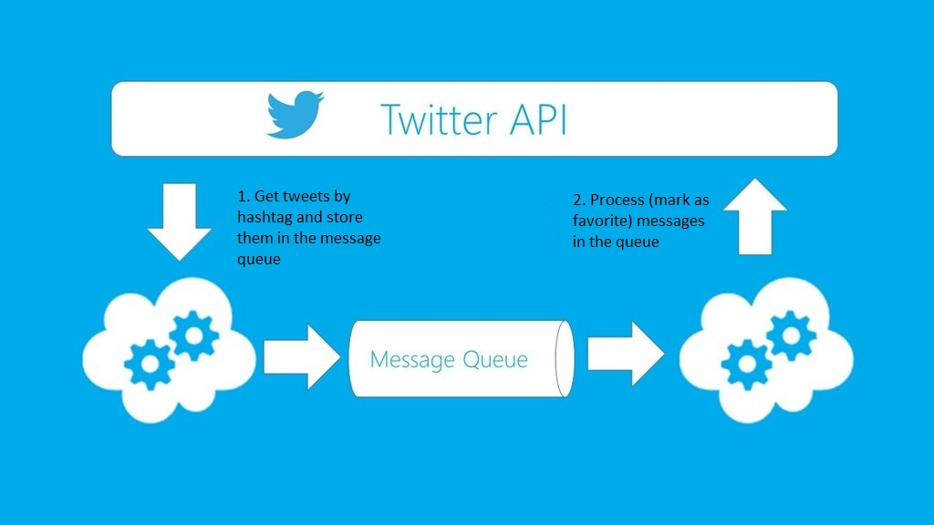
Method Of Data Collection
In order to survey public opinion on health, data was collected by text mining Twitter, using Twitter API. This provided access to a high volume of tweets to analyze.

Slide 4
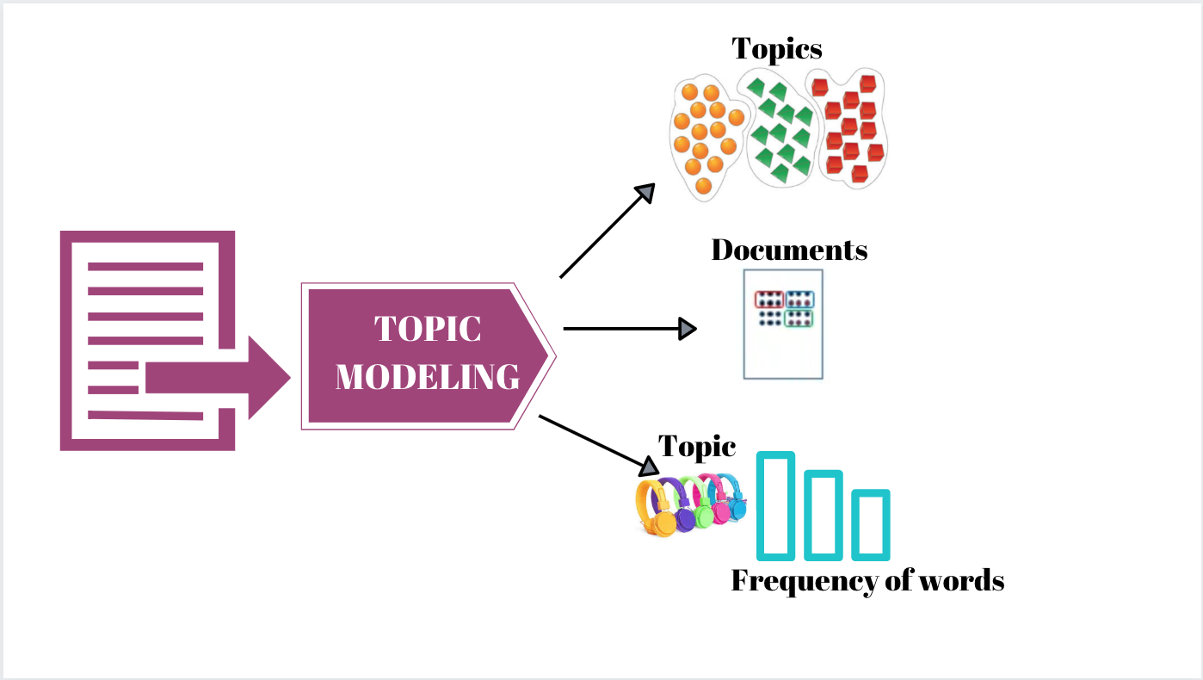
Method Of Data Analysis
Topic Modeling was used to aid in the analysis of food related tweets. The Topic Model is a common statistical model for highlighting topics that appear frequently in a collection of documents.
Sentiment Analysis was used to gauge which tweets were positive or negative.

Slide 5
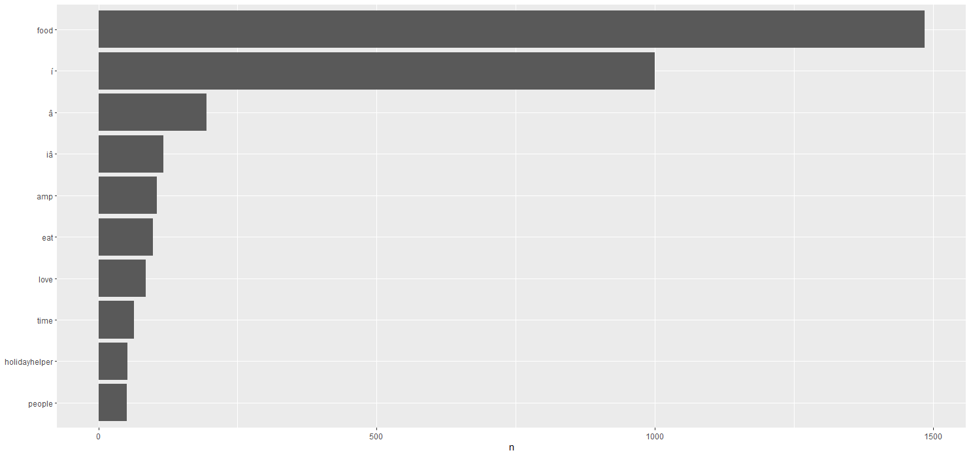
Words Having More Than 50 Frequency (Results)
food
İ
ȧ
iȧ
amp
eat
love
time
holidayhelper
people

Slide 6
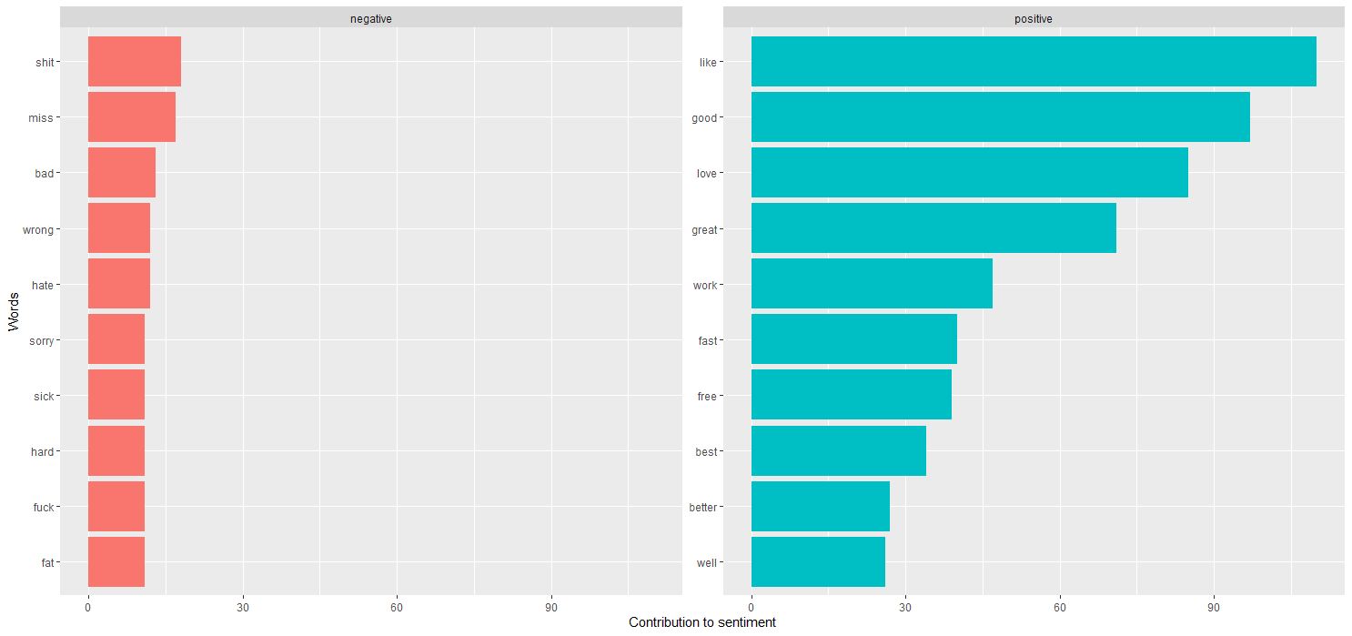
Top 10 Positive & Negative Sentiment (Results)
shit
like
miss
good
bad
love
wrong
great
hate
work
sorry
fast
sick
free
hard
best
fuck
better
fat
well

Slide 7
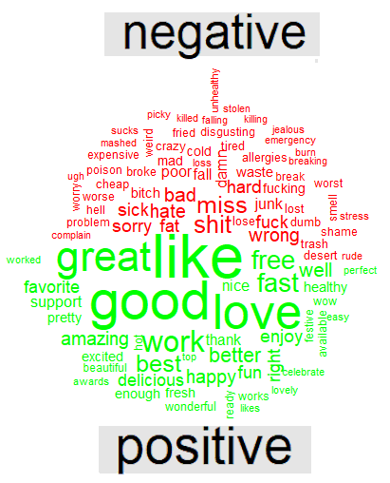
Word Cloud Of Positive and Negative Words (Results)

Slide 8
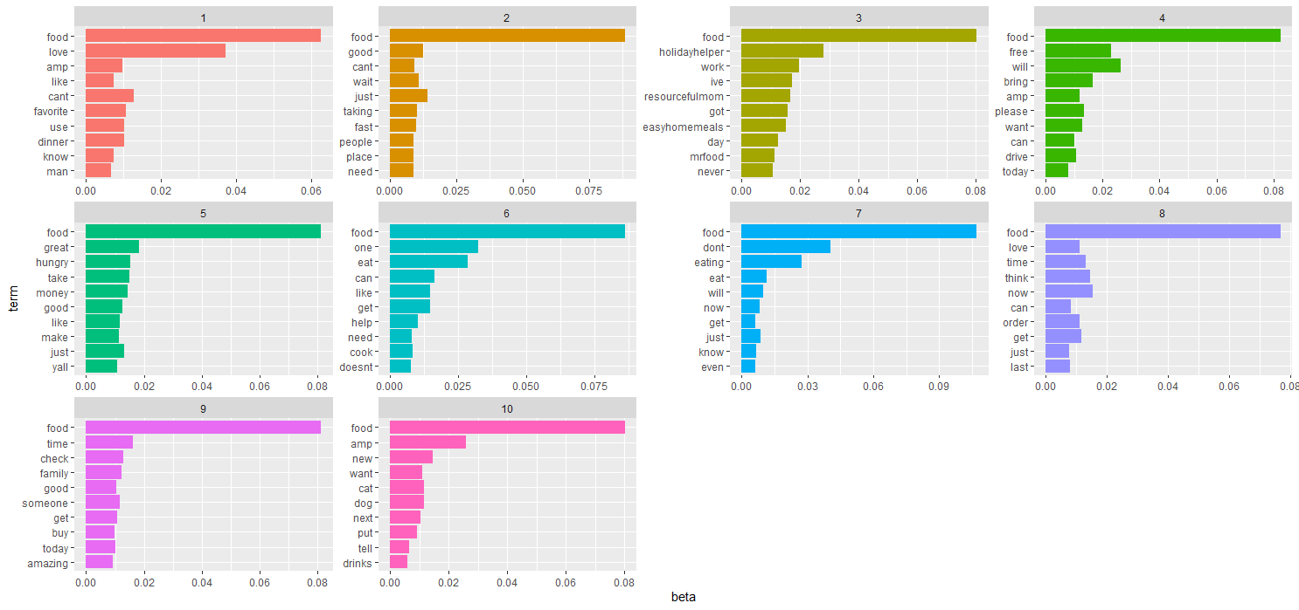
Top 10 Topics (Results)

Slide 9
Conclusion
In conclusion, Social Media is a powerful resource for collecting data on specific topics. Using tools like the Sentiment Analysis and Topic Modeling packages in R, we gained insight on twitter users’ opinions of food and activities related to food such as holiday celebrations. Health and Nutrition were notably less of a concern to users than taste or convenience.
Obesity rates in the United States could be attributed to the popularity of fast food and apathy towards nutrition.

